Slide 1
Web Simulator, for LDO and Load-Switch-IC
Introduction and How to use
July 2013

Slide 2
Introduction
Purpose
- To provide overview for Toshiba’s Web Simulator
Objectives
- Overview of Toshiba’s Web Simulator
- Overview for LDO and Load Switch IC
- How to register
- How to use the Simulator for LDO and Load switch IC
Content
- 14 pages as main content, 24pages as all
Learning Time
- 7 minutes as main content, 15 minutes as all
Notes:
2
Welcome to the product training module for Toshiba’s web simulator. This presentation will provide an overview for Toshiba’s Web simulator and step-by-step instructions on registration, and using the simulator for the LDO regulators and load switch ICs you will find on Digikey’s websites.

Slide 3
Overview of Web Simulator,
Overview of LDO and Load switch IC

Slide 4
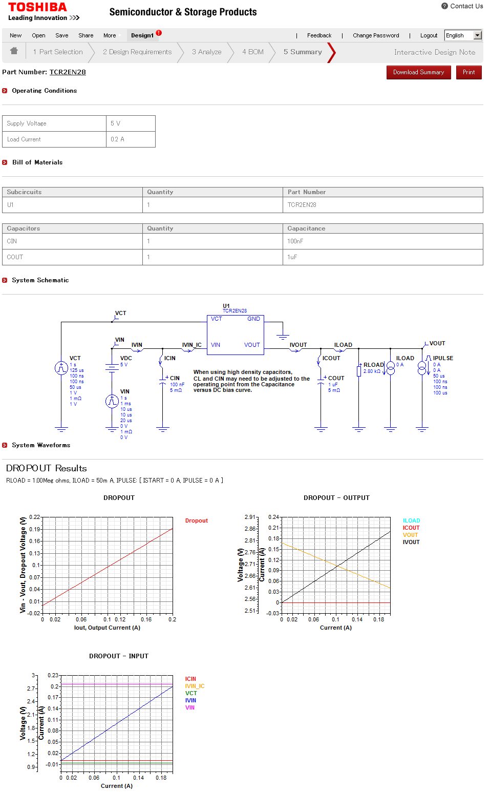
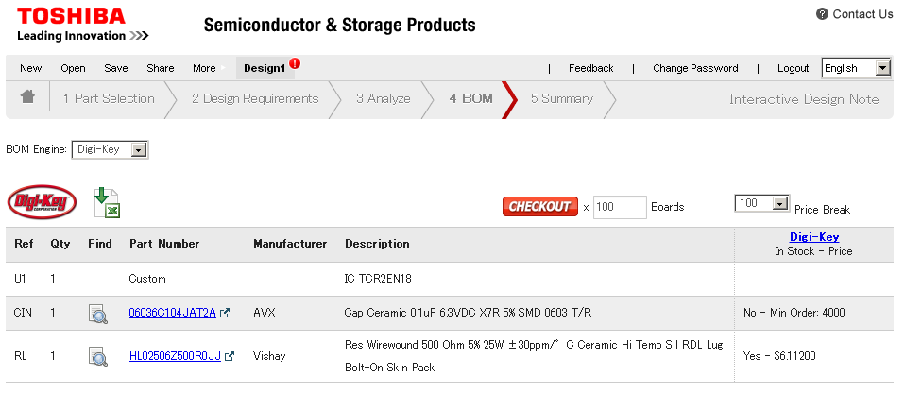
Overview of Web Simulator (LDO, Load Switch IC)
INTERACTIVE DATASHEET
For Analog IC, especially for power, detailed characteristics are needed for set design. TOSHIBA provides reference data to complement the datasheet with actual usage conditions, that is the INTERACTIVE DATASHEET . In addition, support for DIRECT ONLINE ORDER of devices from Web Simulator.
DIRECT ONLINE ORDER
Notes:
The web simulator consists of 2 portions.
For Analog IC, especially for power applications, detailed characteristics and conditions are required for set design. TOSHIBA’s INTERACTIVE DATASHEET provides reference data to complement the datasheet using the designer’s actual circuit conditions. In addition, support for DIRECT ONLINE ORDER of devices is available from the Web Simulator.

Slide 5
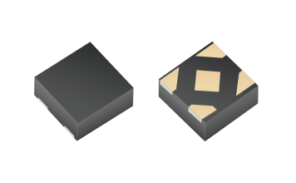
Overview of LDO and Load-switch-IC
TCR2EN series:
R.R. =73dB@f=1kHz, Vout=2.5V
Low Drop-Out (LDO) regulators are highly accurate power supply ICs which are typically under 500mA, and frequently used in a wide range of electronic devices.
Input from
DCDC or
Noisy-supply
V_{INPUT}
LDO
or
t
Output
Stable and
Highly accurate
V_{INPUT}
Input from
Higher-different-
voltage
t
V_{INPUT}
t
Application note: http://www.semicon.toshiba.co.jp/info/docget.jsp?type=AplNote1&lang=en&pid=TCR2EN28
Load switch IC for general power management with a lot of useful functions, also has low-switch-ON resistance at low voltage operation. As compare from MOSFET, they are excellent for ease of use and good performance.
Load Switch IC
Over current protection
Thermal shut down
Revers current block
Auto discharge
Slew rate control
Charge pump
Application note: http://www.semicon.toshiba.co.jp/info/docget.jsp?type=AplNote1&lang=en&pid=TCK107G
Notes:
Low Drop-Out(LDO) regulators are highly accurate power supply ICs and are typically available up to 500mA where they are most efficient. One of the main application is to provide systems with a lower stable voltage from a higher voltage rail, and another is to smoothen noise and ripples that frequently occur in noisy supply rails coming from AC-DC converters or DC-DC converters. Even standard LDO regulators like Toshiba’s TCR2EN series provide top range ripple rejection at 73dB for a 2.5V output LDO at a frequency of 1kHz.
Load switch ICs general purpose power management load switches embedded with functions to cater various needs like over current protection, thermal overheating protection, reverse current flow protection, in-rush current reduction, etc. On top of these embedded functions, they also have low switch-ON resistance even at low voltage operation, which make them easy to use and yet better performing than similar sized discrete MOSFETs.

Slide 6
How to register

Slide 7
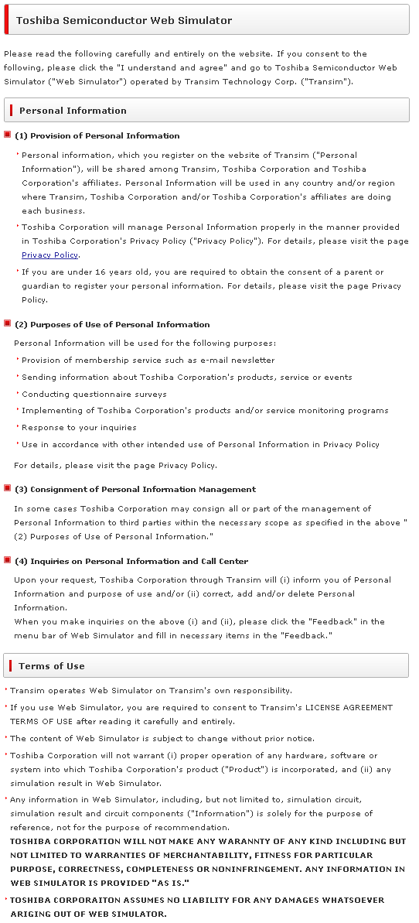
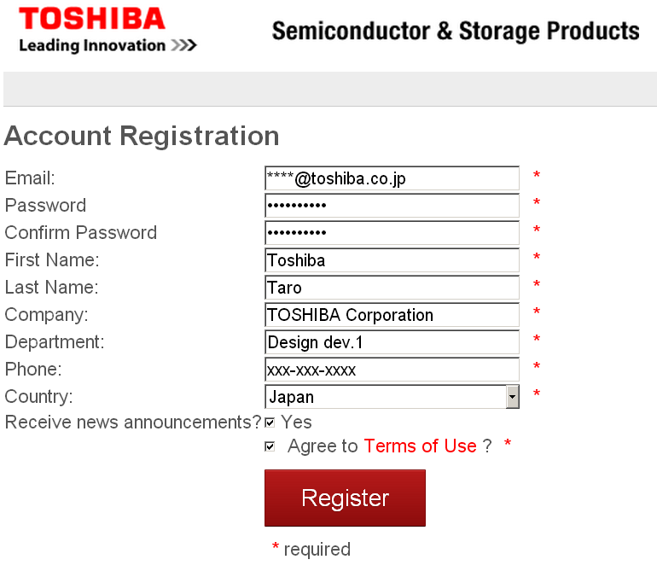
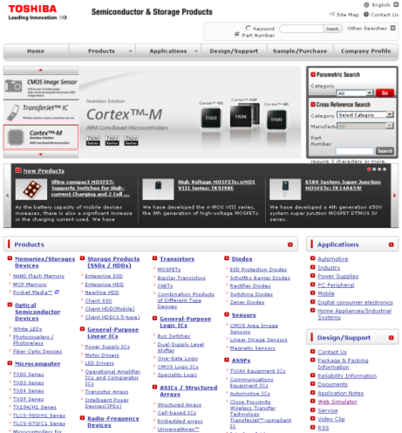
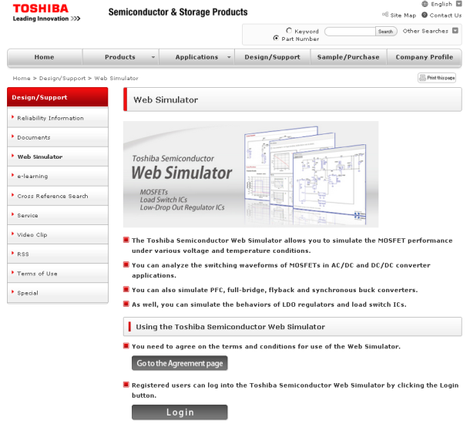
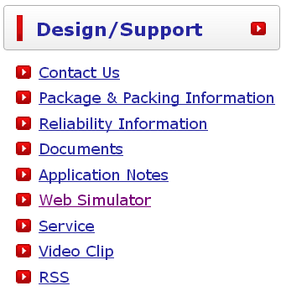
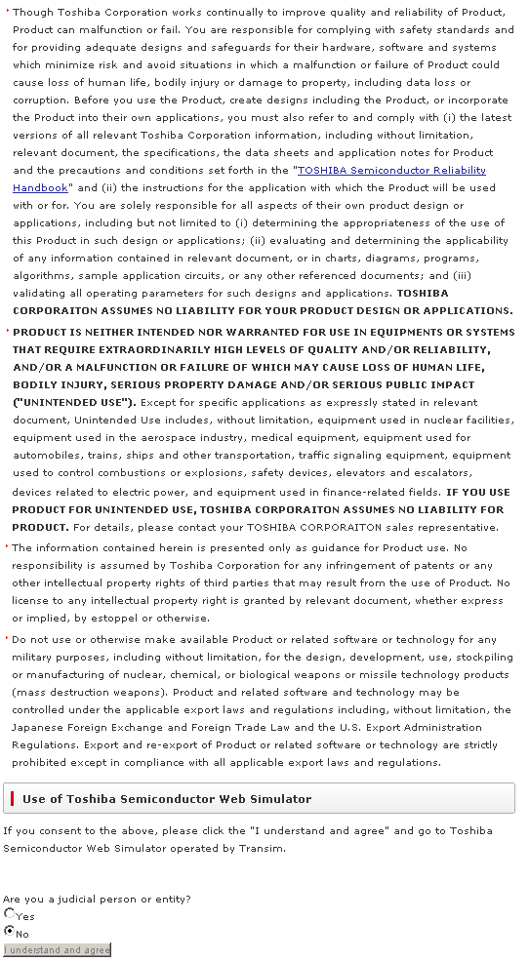
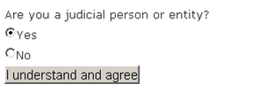
How to Register
http://www.semicon.toshiba.co.jp/eng/index.html
Click to start registration
Agreement
Notes:
7
Access the Toshiba homepage as given in the link above, and click on the web simulator link to bring you to the starting page for the Web Simulator. Follow the steps shown above to start registration, agree to the disclaimer, and fill in the necessary information to create your own account!

Slide 8
How to use the Web Simulator

Slide 9
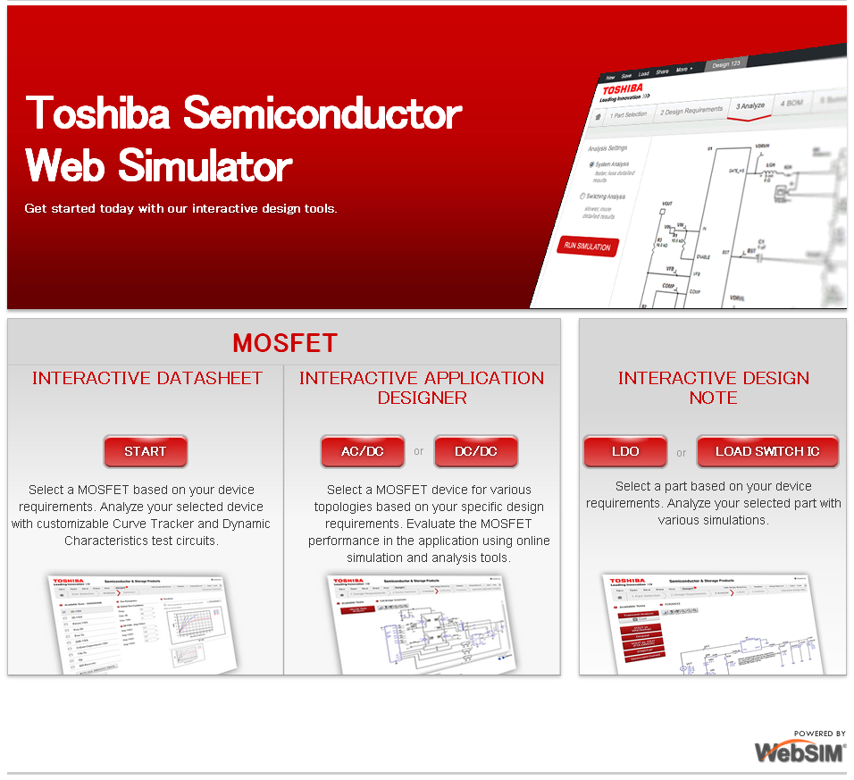
How to use the Simulator -1
LDO,
See Slide 10
Load Switch IC,
See Slide 17
Notes:
This will be the first page you will see when the Web Simulator is launched. For more information on LDO regulators, please refer to Slide 10, and for Load switch ICs, please refer to Slide 17.

Slide 10
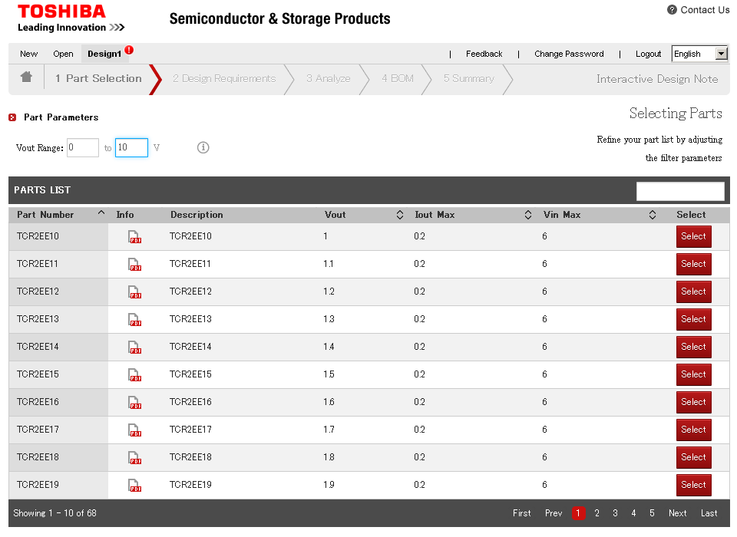
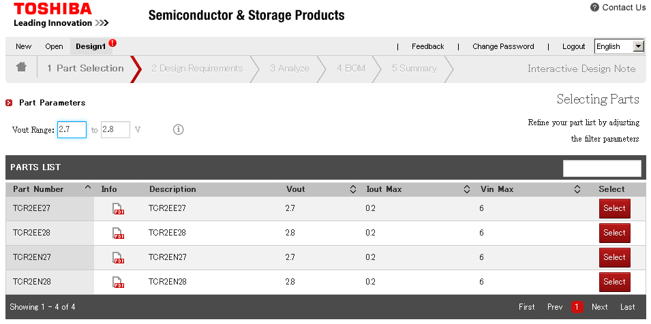
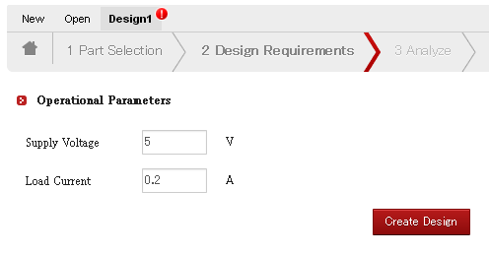
How to use the Simulator -2 LDO, Beginning
1st: Input the output voltage
2nd: Select the part number
3rd: Input conditions
Notes:
Select a suitable LDO regulator by entering the output voltage, followed by the part number depending on the series and package, and then the supply voltage and load current conditions.

Slide 11
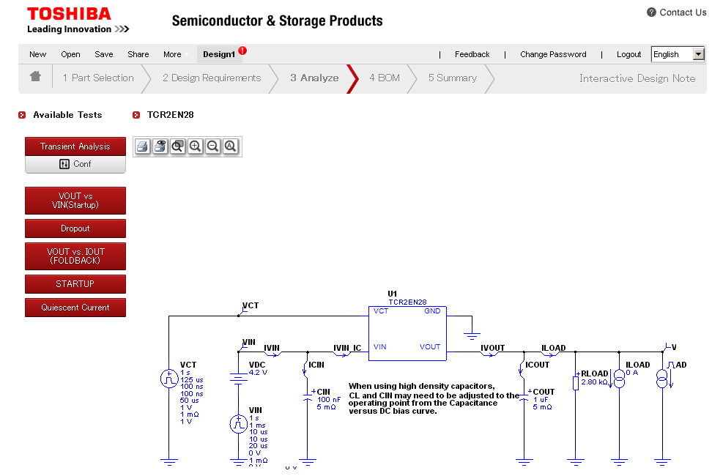
How to use the Simulator -2 LDO, Circuit setting
See slide12
See slide16
See slide17
Input detailed conditions as below,
using preferred circuit conditions
See slide17
See slide18
See slide19
Notes:
The next step would require the designer to select various tests results to be simulated using the Web Simulator. The details on each test will be explained in detail in the following slides. At this stage, the designer is able to edit the parameters for each input and output like control voltage and current, capacitance values, load current, etc. This flexibility allows the designer to simulate using conditions similar to their own.
Slide 12 provides more details on transient response analysis, slides 16 – 19 provide detailed information on simulation for other characteristics like dropout, current limiting characteristics, startup AC characteristics and also quiescent current based on circuit design parameters.

Slide 12
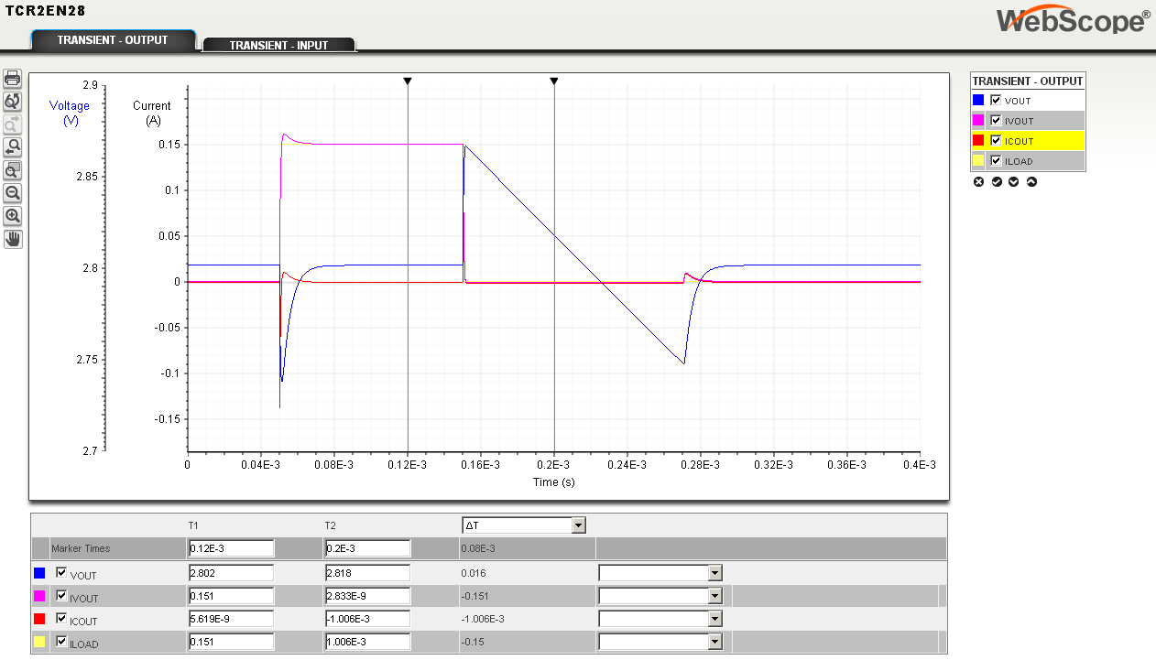
How to use the Simulator -2 LDO, Transient analysis
T1
T2
Voltage and Current
curves on same graph
Heavy
load
Light
load
Voltage
axis
Current
axis
You can read specific value,
through input T1, T2 value
You can see the Transient-waveform,
caused by load current changing
Notes:
The web simulator allows the designer to check transient characteristics caused by changing load current conditions which occurs frequently during operation. This simulation provides both output transient voltage and current simulation, and input transient simulations so designers can simulate the conditions (ie. Voltage drop) that will occur, which is crucial to analog designers. The voltage and current curves are superimposed to provide a better understanding of the correlation between the 2.

Slide 13
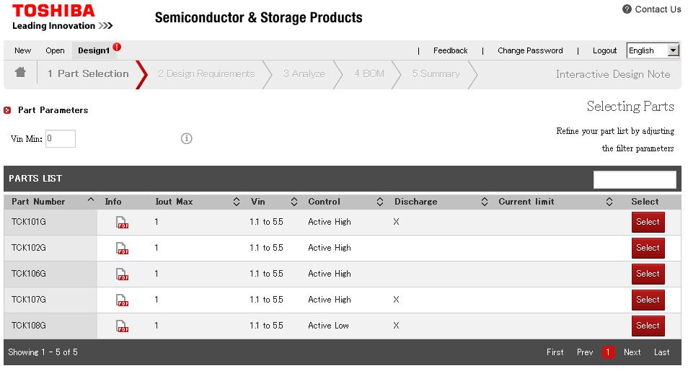
How to use the Simulator -2 Load Switch, Beginning
1st: Input condition
2nd: Select the parts number
“X” mean “support”
Notes:
Similarly, simulation can be done on load switch ICs by entering the minimum input voltage, followed by the part number depending on the series and package. Make sure to check that the required auxiliary function is support by checking if the respective function has a cross, which means it is supported and no cross, which means it is not supported in that device. The corresponding simulations will differ depending on the supporting features available.

Slide 14
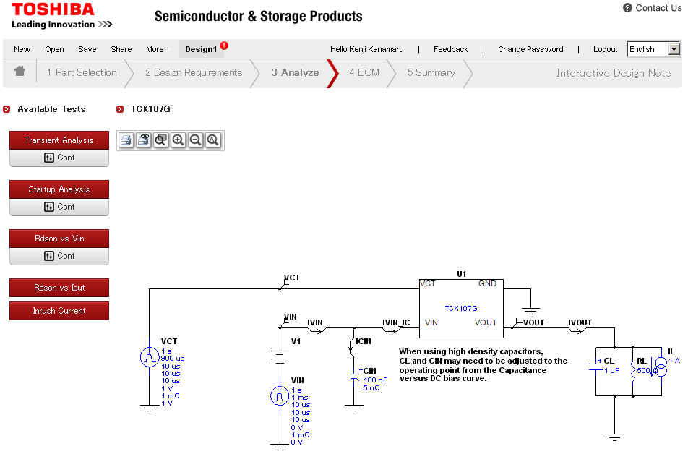
How to use the Simulator -2 Load Switch, Circuit setting
See slide20
See slide21
Input detailed conditions as below,
using preferred circuit conditions
See slide22
See slide23
See slide24
Notes:
Slide 20 provides more details on transient response analysis, slides 21 – 24 provide detailed information on simulation for other characteristics like startup AC characteristics and also Rdson characteristics and inrush current based on circuit design parameters.

Slide 15
Appendix

Slide 16
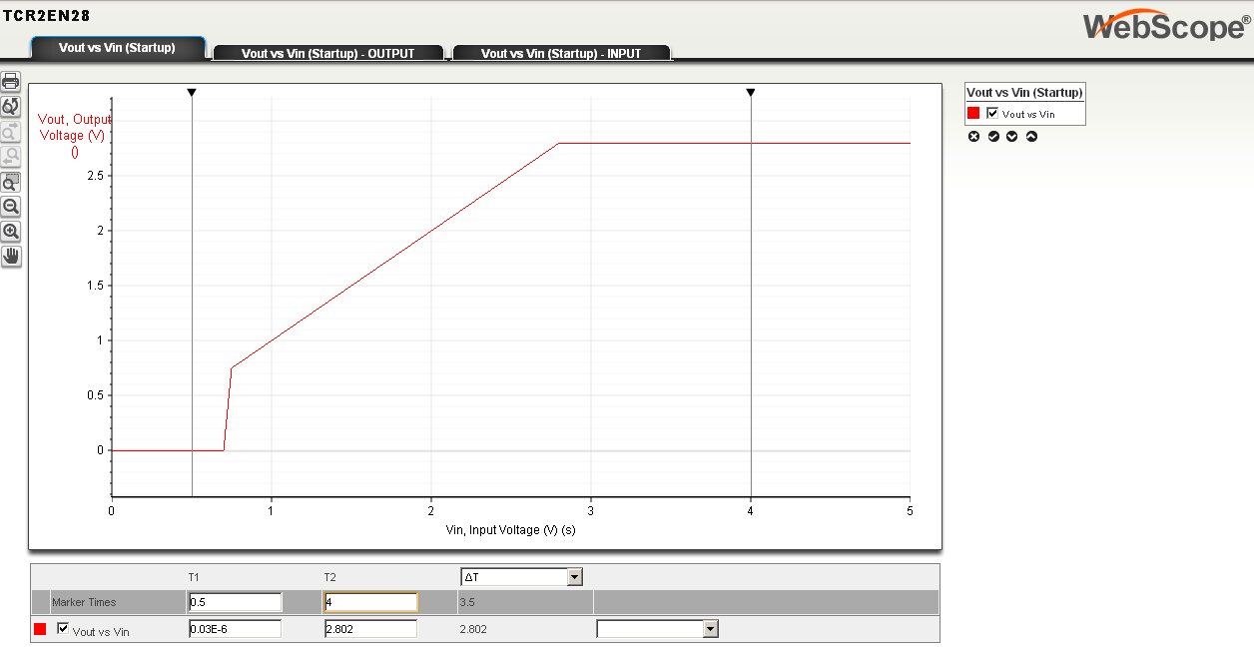
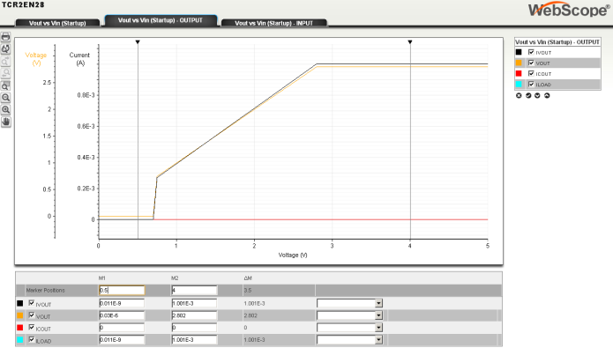
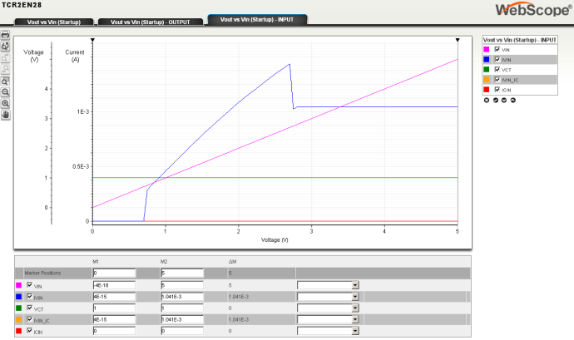
How to use the Simulator -2 LDO, VOUT vs VIN
T1
T2
Vin, Time
axis
Vout
axis
Vin = +1V/s
You can read specific value,
through input T1, T2 value
Other than the Vin-Vout curve,
Switching between the upper tabs, Vin-Iin, Vin-Ib can be viewed
Notes:
Other than Vin-Vout characteristics, this test allows the designer to plot other curves to understand how important characteristics vary with changes in the input voltage, for example to find the ideal input voltage conditions. The other parameters provided are input voltage vs input current (Vin-Iin), and input voltage vs quiescent current (Vin-Ib).

Slide 17
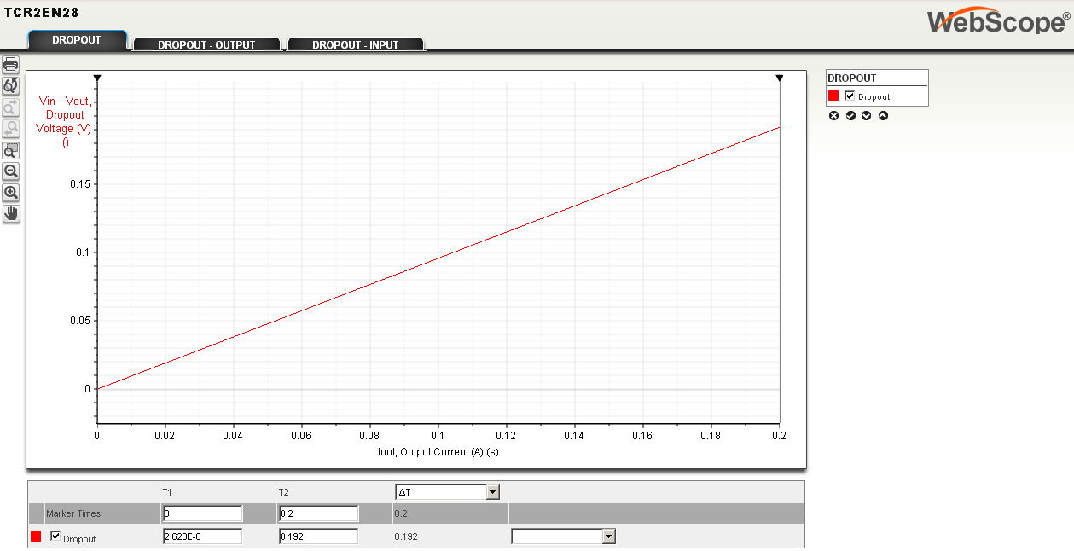
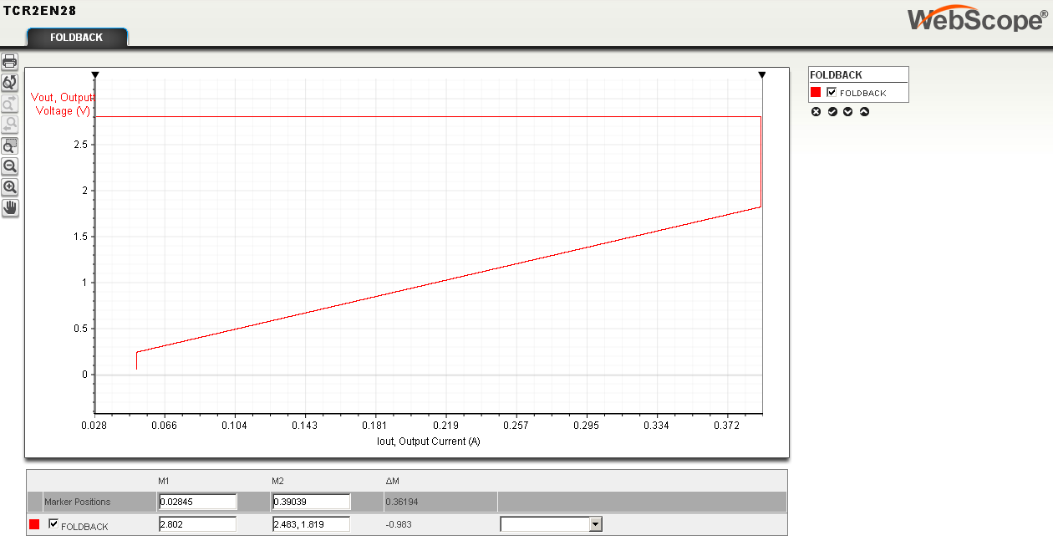
How to use the Simulator -2 LDO, Dropout/Vout-Iout
Iout, Time
axis
Vout
axis
Iout=+1A/s
Iout, axis
Vout
axis
You can see the related curve of Vout and Iout
Notes:
These series of tests allows the designer to plot dropout (VIN-VOUT) as output or load current varies. Vout-Iout provides the foldback curve of the current limiting feature in Toshiba’s LDO regulators.

Slide 18
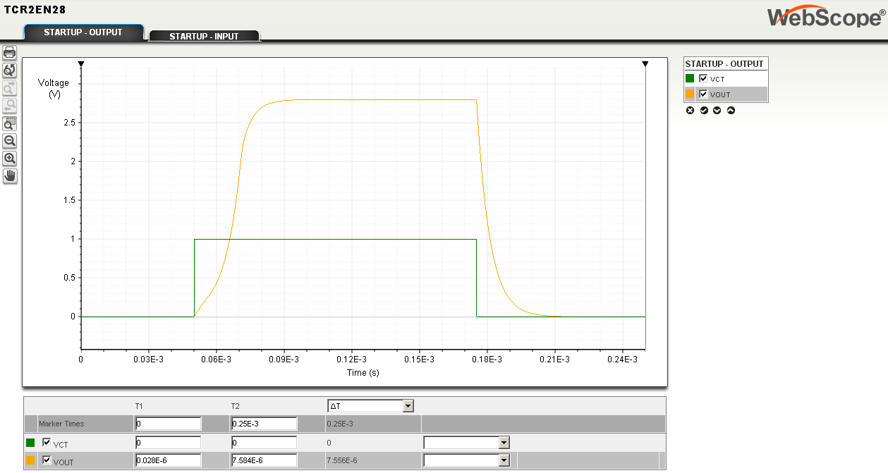
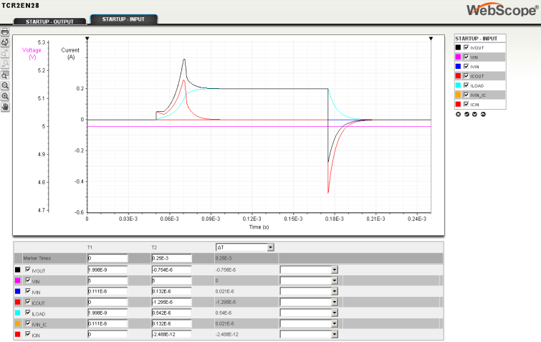
How to use the Simulator -2 LDO, Startup
Vout
disable
Vout
enable
Vout
disable
Voltage
axis
Time
axis
Vout
enable
Vout
disable
Vout
axis
You can read specific value,
through input T1, T2 value
Current
axis
Time
axis
The output voltage Vout is enabled/disabled,
And the current curves in other words inrush current curves.
Notes:
These series of tests are used to understand the AC characteristics or in other words the control response speed and output response speed of the device, which varies according to the type and value of capacitors used and other circuit characteristics. This flexibility allows the designer simulate using chosen capacitors in their circuits. The “Startup – output“ tab shows the rise and fall characteristics as the control signal enables/disables the output.
The second tab (“Startup-input”) shows the inrush current at the input given by “IVIN” and the inrush current seen at the output capacitor given by “ICOUT”, which is useful to understand the transient current draw when the output is triggered ON or OFF.
The specific values can also be measured by inputting desired T1 and T2 values.

Slide 19
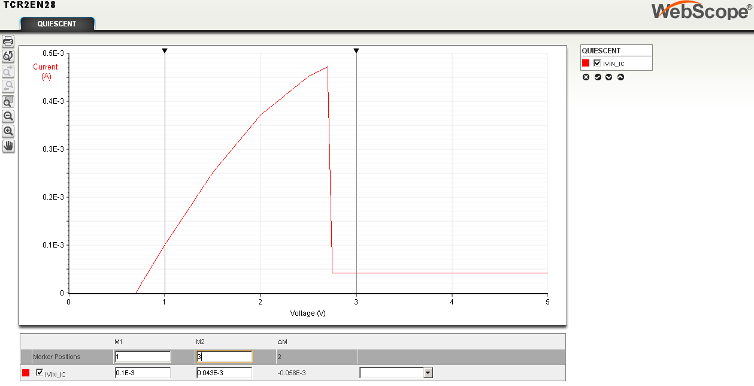
How to use the Simulator -2 LDO, Quiescent current
Voltage
axis
Current
axis
You can read specific value,
through input M1, M2 value
You can see the related curve of Vin and Ib
Notes:
This test gives quiescent current characteristics as input voltage is adjusted.

Slide 20
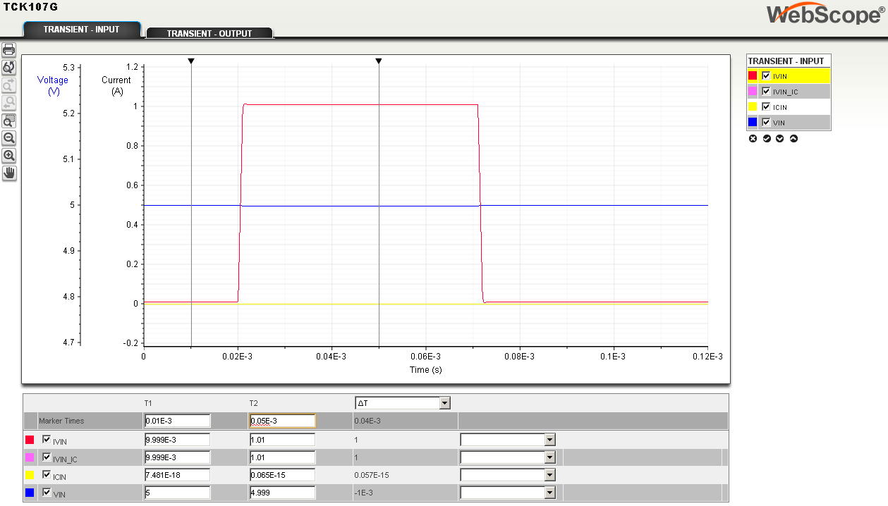
How to use the Simulator -2 Load Switch, Transient analysis
T1
T2
Voltage and Current
curves on same graph
Heavy
load
Light
load
Voltage
axis
Current
axis
Time
axis
You can read specific value,
through input T1, T2 value
You can see the Transient-waveform,
what be made by load current changing
Notes:
The web simulator allows the designer to check transient characteristics caused by changing load current conditions which occurs frequently during operation. This simulation provides both output transient voltage and current simulation, and input transient simulations so designers can simulate the conditions (ie. Voltage drop) that will occur, which is crucial to analog designers. The voltage and current curves are superimposed to provide a better understanding of the correlation between the 2.
The specific values can also be measured by inputting desired T1 and T2 values.

Slide 21
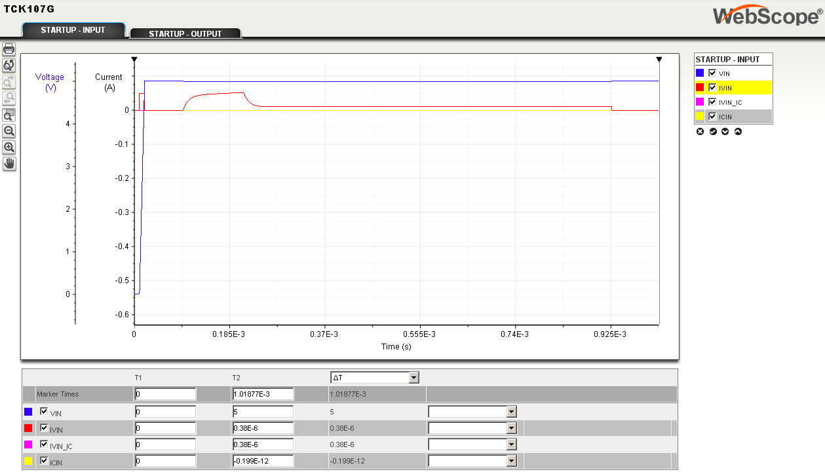
How to use the Simulator -2 Load Switch, Startup
Output ON
Output OFF
Voltage
axis
Current
axis
Time
axis
You can read specific value,
through input T1, T2 value
Notes:
The startup characteristics for both voltage and current is shown in these tests.

Slide 22
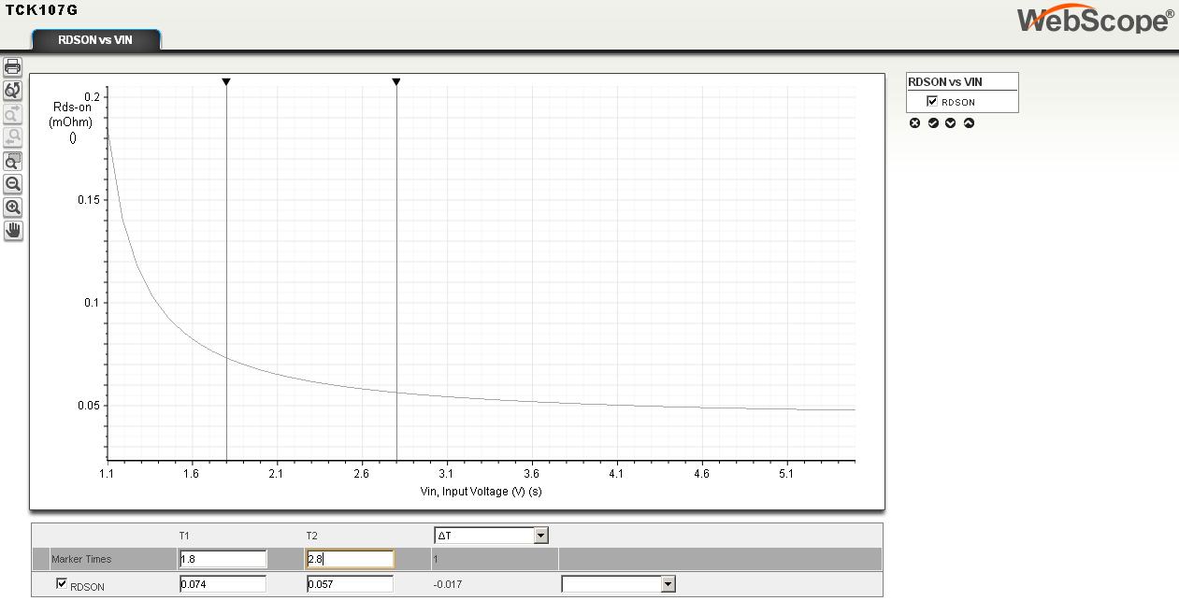
How to use the Simulator -2 Load Switch, Ron vs Vin
T1
T2
Voltage
axis
Ron
axis
You can read specific value,
through input T1, T2 value
You can see the related curve of Ron vs Vin
Notes:
This simulation allows the designer to check RDSON characteristics as input voltage varies.

Slide 23
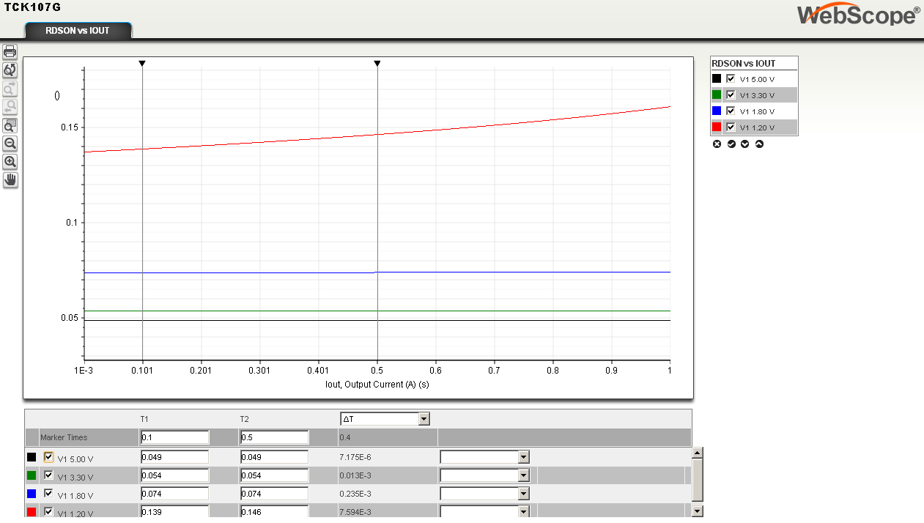
How to use the Simulator -2 Load Switch, Ron vs Iout
T1
T2
Vin=5.0V
Vin=3.3V
Vin=1.8V
Vin=1.2V
Ron
axis
Current
axis
You can read specific value,
through input T1, T2 value
You can see the related curve of Ron vs Iout
Notes:
This simulation allows the designer to check RDSON characteristics as output current varies.

Slide 24
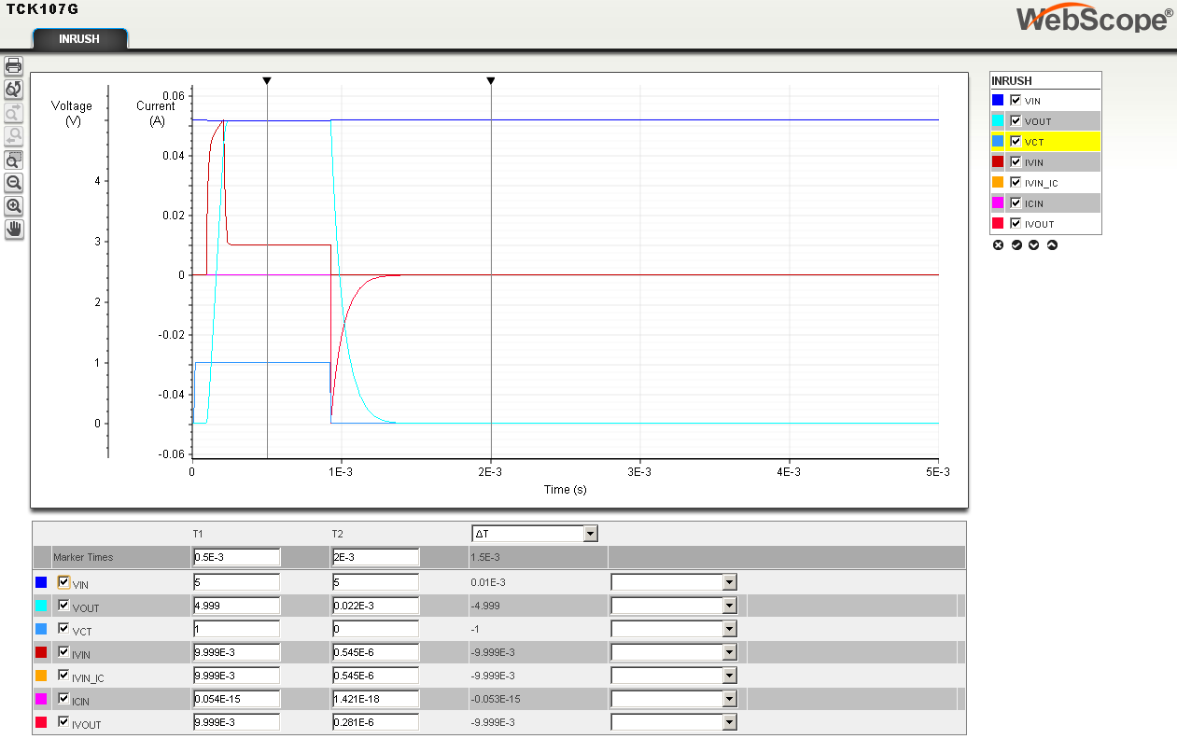
How to use the Simulator -2 Load Switch, Inrush
Output
ON
Output
OFF
Voltage
axis
Current
axis
Time
axis
You can read specific value,
through input T1, T2 value
The transition waveform as output is triggered ON and OFF
Notes:
Lastly, as the switch is triggered ON and OFF, the resulting inrush current can be observed using this test output. Inrush current at the input given by “IVIN”.

Slide 25
RESTRICTIONS ON PRODUCT USE
Toshiba Corporation, and its subsidiaries and affiliates (collectively “TOSHIBA”), reserve the right to make changes to the information in this document, and related hardware, software and systems (collectively “Product”) without notice.
This document and any information herein may not be reproduced without prior written permission from TOSHIBA. Even with TOSHIBA’s written permission, reproduction is permissible only if reproduction is without alteration/omission.
Though TOSHIBA works continually to improve Product's quality and reliability, Product can malfunction or fail. Customers are responsible for complying with safety standards and for providing adequate designs and safeguards for their hardware, software and systems which minimize risk and avoid situations in which a malfunction or failure of Product could cause loss of human life, bodily injury or damage to property, including data loss or corruption. Before customers use the Product, create designs including the Product, or incorporate the Product into their own applications, customers must also refer to and comply with (a) the latest versions of all relevant TOSHIBA information, including without limitation, this document, the specifications, the data sheets and application notes for Product and the precautions and conditions set forth in the "TOSHIBA Semiconductor Reliability Handbook" and (b) the instructions for the application with which the Product will be used with or for. Customers are solely responsible for all aspects of their own product design or applications, including but not limited to (a) determining the appropriateness of the use of this Product in such design or applications; (b) evaluating and determining the applicability of any information contained in this document, or in charts, diagrams, programs, algorithms, sample application circuits, or any other referenced documents; and (c) validating all operating parameters for such designs and applications. TOSHIBA ASSUMES NO LIABILITY FOR CUSTOMERS' PRODUCT DESIGN OR APPLICATIONS.
Product is intended for use in general electronics applications (e.g., computers, personal equipment, office equipment, measuring equipment, industrial robots and home electronics appliances) or for specific applications as expressly stated in this document. Product is neither intended nor warranted for use in equipment or systems that require extraordinarily high levels of quality and/or reliability and/or a malfunction or failure of which may cause loss of human life, bodily injury, serious property damage or serious public impact (“Unintended Use”). Unintended Use includes, without limitation, equipment used in nuclear facilities, equipment used in the aerospace industry, medical equipment, equipment used for automobiles, trains, ships and other transportation, traffic signaling equipment, equipment used to control combustions or explosions, safety devices, elevators and escalators, devices related to electric power, and equipment used in finance-related fields. Do not use Product for Unintended Use unless specifically permitted in this document.
Do not disassemble, analyze, reverse-engineer, alter, modify, translate or copy Product, whether in whole or in part.
Product shall not be used for or incorporated into any products or systems whose manufacture, use, or sale is prohibited under any applicable laws or regulations.
The information contained herein is presented only as guidance for Product use. No responsibility is assumed by TOSHIBA for any infringement of patents or any other intellectual property rights of third parties that may result from the use of Product. No license to any intellectual property right is granted by this document, whether express or implied, by estoppel or otherwise.
ABSENT A WRITTEN SIGNED AGREEMENT, EXCEPT AS PROVIDED IN THE RELEVANT TERMS AND CONDITIONS OF SALE FOR PRODUCT, AND TO THE MAXIMUM EXTENT ALLOWABLE BY LAW, TOSHIBA (1) ASSUMES NO LIABILITY WHATSOEVER, INCLUDING WITHOUT LIMITATION, INDIRECT, CONSEQUENTIAL, SPECIAL, OR INCIDENTAL DAMAGES OR LOSS, INCLUDING WITHOUT LIMITATION, LOSS OF PROFITS, LOSS OF OPPORTUNITIES, BUSINESS INTERRUPTION AND LOSS OF DATA, AND (2) DISCLAIMS ANY AND ALL EXPRESS OR IMPLIED WARRANTIES AND CONDITIONS RELATED TO SALE, USE OF PRODUCT, OR INFORMATION, INCLUDING WARRANTIES OR CONDITIONS OF MERCHANTABILITY, FITNESS FOR A PARTICULAR PURPOSE, ACCURACY OF INFORMATION, OR NONINFRINGEMENT.
GaAs (Gallium Arsenide) is used in Product. GaAs is harmful to humans if consumed or absorbed, whether in the form of dust or vapor. Handle with care and do not break, cut, crush, grind, dissolve chemically or otherwise expose GaAs in Product.
Product may include products using GaAs (Gallium Arsenide). GaAs is harmful to humans if consumed or absorbed, whether in the form of dust or vapor. Handle with care and do not break, cut, crush, grind, dissolve chemically or otherwise expose GaAs in Product.
Do not use or otherwise make available Product or related software or technology for any military purposes, including without limitation, for the design, development, use, stockpiling or manufacturing of nuclear, chemical, or biological weapons or missile technology products (mass destruction weapons). Product and related software and technology may be controlled under the Japanese Foreign Exchange and Foreign Trade Law and the U.S. Export Administration Regulations. Export and re-export of Product or related software or technology are strictly prohibited except in compliance with all applicable export laws and regulations.
Product is subject to foreign exchange and foreign trade control laws.
Product may include products subject to foreign exchange and foreign trade control laws.
The technical information described in this document is subject to foreign exchange and foreign trade control laws.
Please contact your TOSHIBA sales representative for details as to environmental matters such as the RoHS compatibility of Product. Please use Product in compliance with all applicable laws and regulations that regulate the inclusion or use of controlled substances, including without limitation, the EU RoHS Directive. TOSHIBA assumes no liability for damages or losses occurring as a result of noncompliance with applicable laws and regulations.

